Slide 1

01
Exploring the Potential of NLP for Medical Record Summarization and Named Entity Recognition
Overview of Report and Proof of Concept
-Ishita Ajay Trivedi
Syracuse University

Slide 2

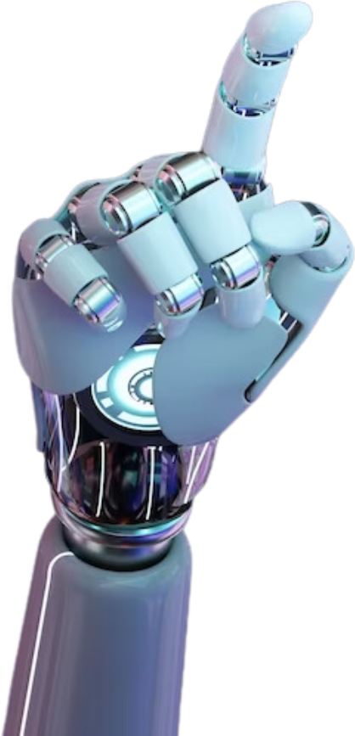
02
Introduction
Background:
Medical records are critical but often lengthy and complex.
Healthcare professionals need quick access to key information.
Objective:
Develop a text summarization system for medical records.
Improve efficiency and accuracy in accessing patient information.

Slide 3


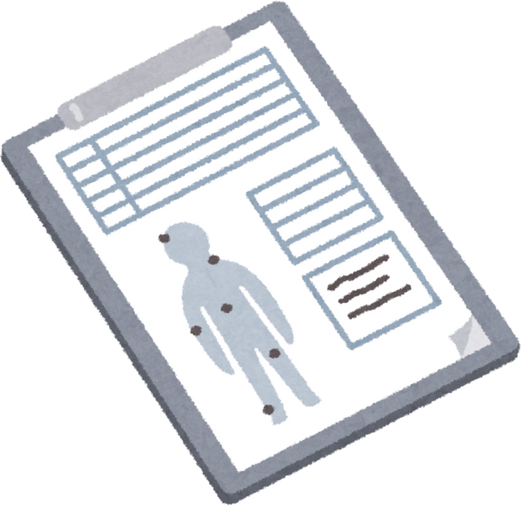
03
Problem Statement
Lengthy Records:
Medical records contain extensive and detailed information.
Critical Need:
Quick extraction of critical data is essential for clinical decision-making.

Slide 4



04
METHODOLOGY
DATA COLLECTION
NAMED ENTITY RECOGNITION (NER)
TEXT SUMMARIZATION
Kaggle NBME Score Clinical Patient Notes dataset.
- Data includes clinical notes, discharge summaries, and radiology reports.
- Tokenization and alignment of labels with medical annotations.
- Training on a subset of the dataset.
- Summarized patient notes by condensing the information while retaining the core message.

Slide 5
05
POC WALKTHROUGH

Slide 6
06
Recommendations for Cotiviti
Ethical AI Focus
Refining NLP into Live Insights
Advanced Predictive Analytics
Scalability and Personalization

Slide 7

07
Conclusion
Demonstrated the potential of NLP in transforming healthcare data management.
Highlighted the benefits of automated summarization and NER in improving patient care.

Slide 8


08
Thank You!
istrived@syr.edu
+13158320970

